Slide 1
Introduction to Spark

Slide 2
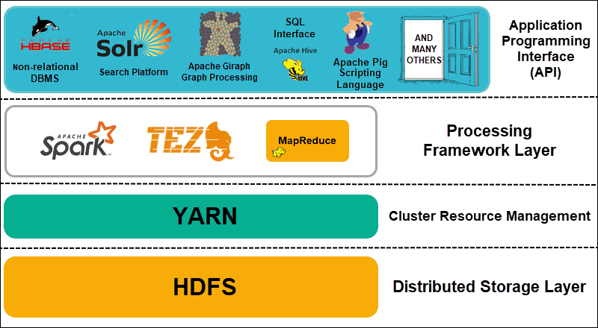
Hadoop Architecture
Distributed Storage
Hadoop Distributed File System (HDFS)
Data is split into blocks then stored in different nodes with their own resources
Master nodes keep metadata
Cluster Resource Management
Yet Another Resource Negotiator (YARN)
Coordinate nodes for data processing
Processing Framework
MapReduce, Spark
Process and analyze data
API
Various applications

Slide 3

Apache Spark
A unified analytics engine for large-scale data processing
Can be built on Hadoop or as a standalone framework
Provides high-level APIs
Languages include Java, Scala, Python and R
Packages higher-level tools including
Spark SQL for SQL and structured data processing
Pandas API on Spark for Pandas workloads
MLlib for machine learning
GraphX for graph processing
Structured Streaming for incremental computation and stream processing

Slide 4
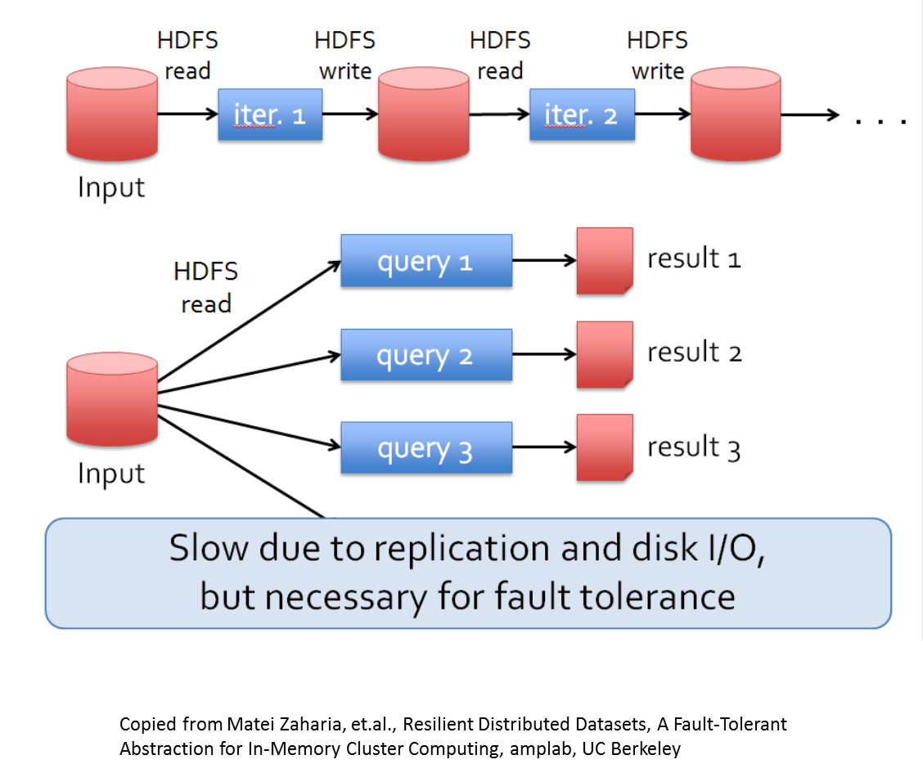
MapReduce Disadvantages
While enabling big data analytics using large, unreliable clusters, MapReduce has a disadvantage in speed
MapReduce reads data from HDFS and outputs data to HDFS
HDFS stores data and replicate on disks for fault tolerances
This means iterative and/or interactive applications are slow due to constant disk IO operations

Slide 5
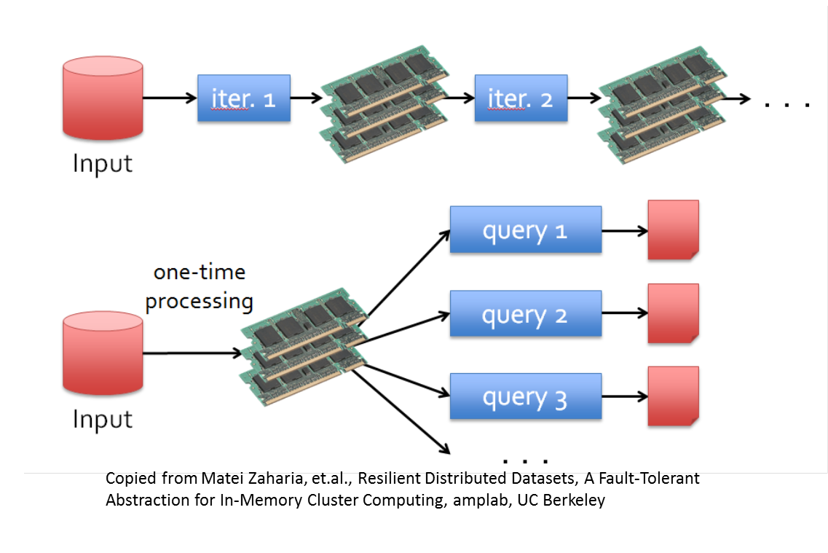
Resilient Distributed Datasets
Spark’s solution to the speed issue of MapReduce is Resilient Distributed Datasets – RDD
Supports in-memory processing and computation
A RDD is
Immutable, partitioned collections of objects
Created through parallel transformations on data in stable storages
Can be cached for efficient reuse

Slide 6
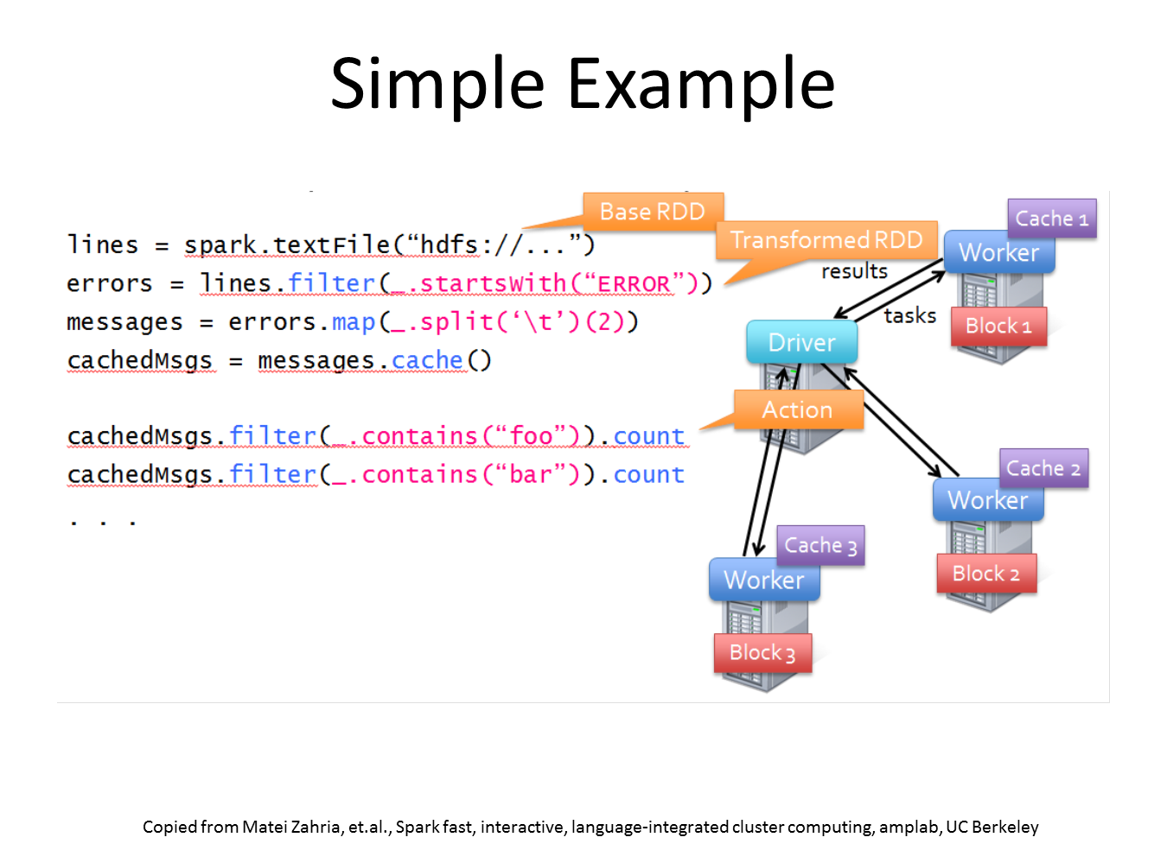
RDD Operations
RDD support two types of operations
Transformation – creating a new dataset from existing ones
Map in MapReduce is a transformation
Action – returning a value from running a computation on a dataset
Reduce in MapReduce is an action

Slide 7
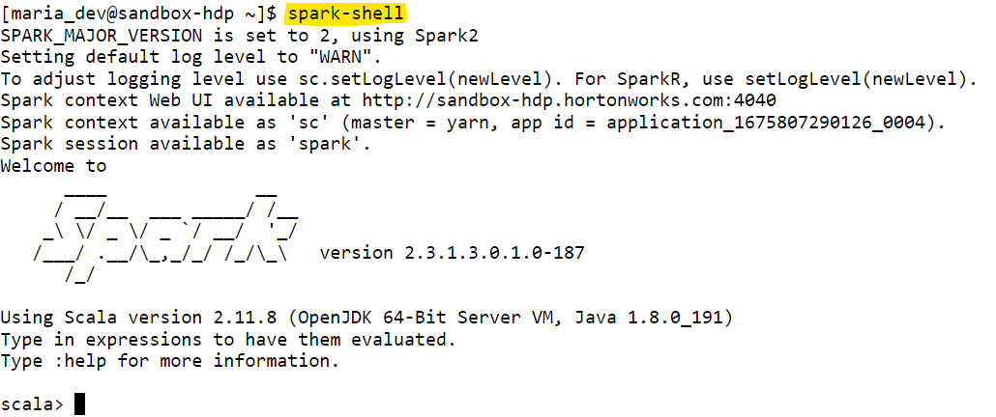
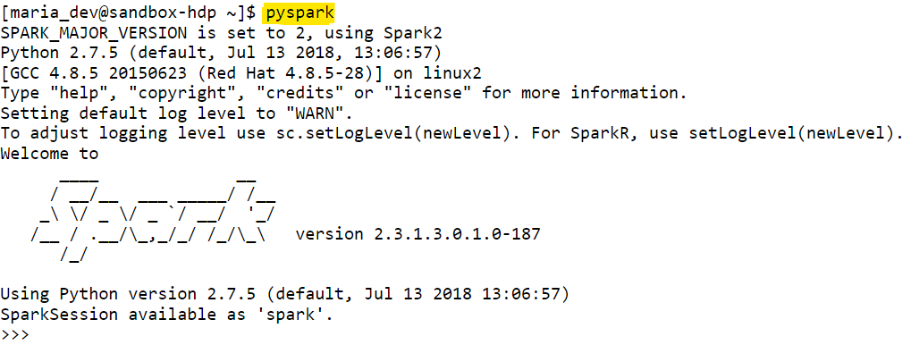
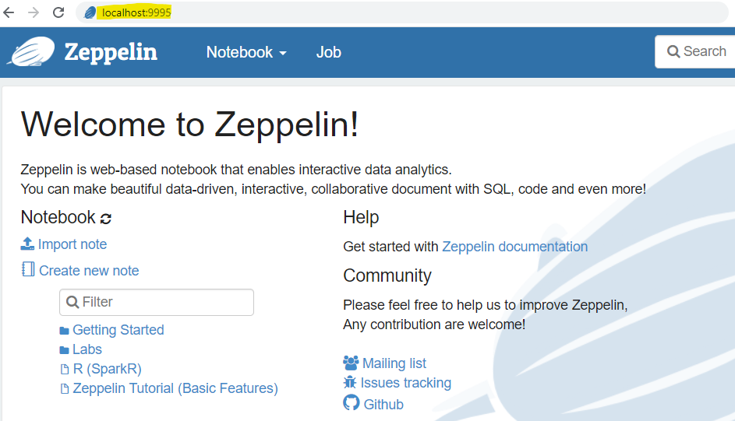
Spark Hands-On
There are multiple ways to access Spark APIs in the Hortonworks Sandbox VM
Shell applications: in the Hadoop SSH, performs
spark-shell: open the Scala environment
pyspark: open the Python environment
UI: go to localhost:9995 to access Zeppelin IDE for Spark
We will use Zeppelin for the rest of the Spark modules

Slide 8
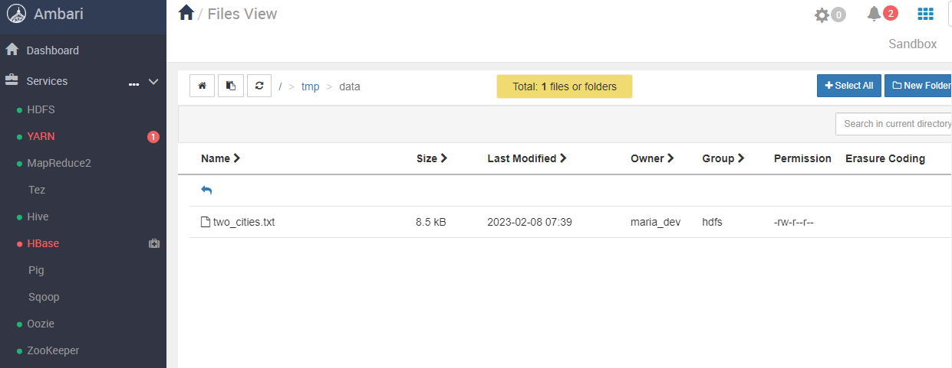
Environment Set up
In HDFS view, go to /tmp/data and upload two_cities.txt there
Create a folder named data if you have not had it

Slide 9
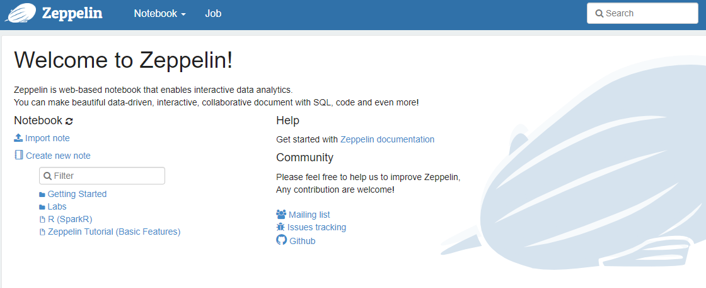
Apache Zeppelin
An interactive IDE for Spark scripts
Accessed at localhost:9995
Basic unit of scripts are notebook (note)
In general, a notebook consists the code for one analysis

Slide 10
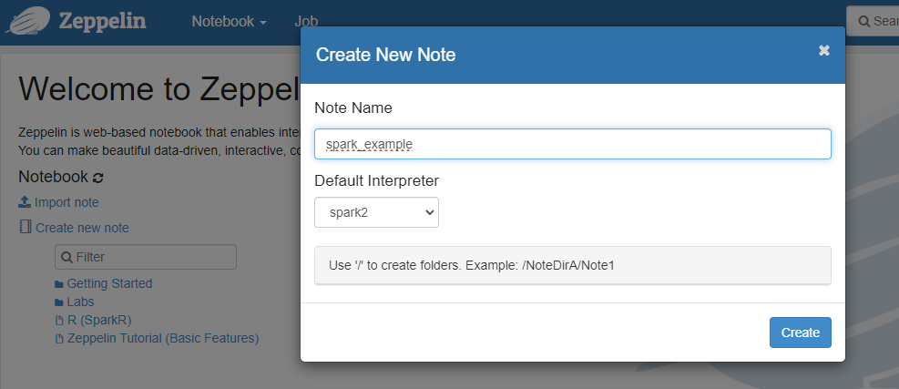
Create New Notebooks

Slide 11
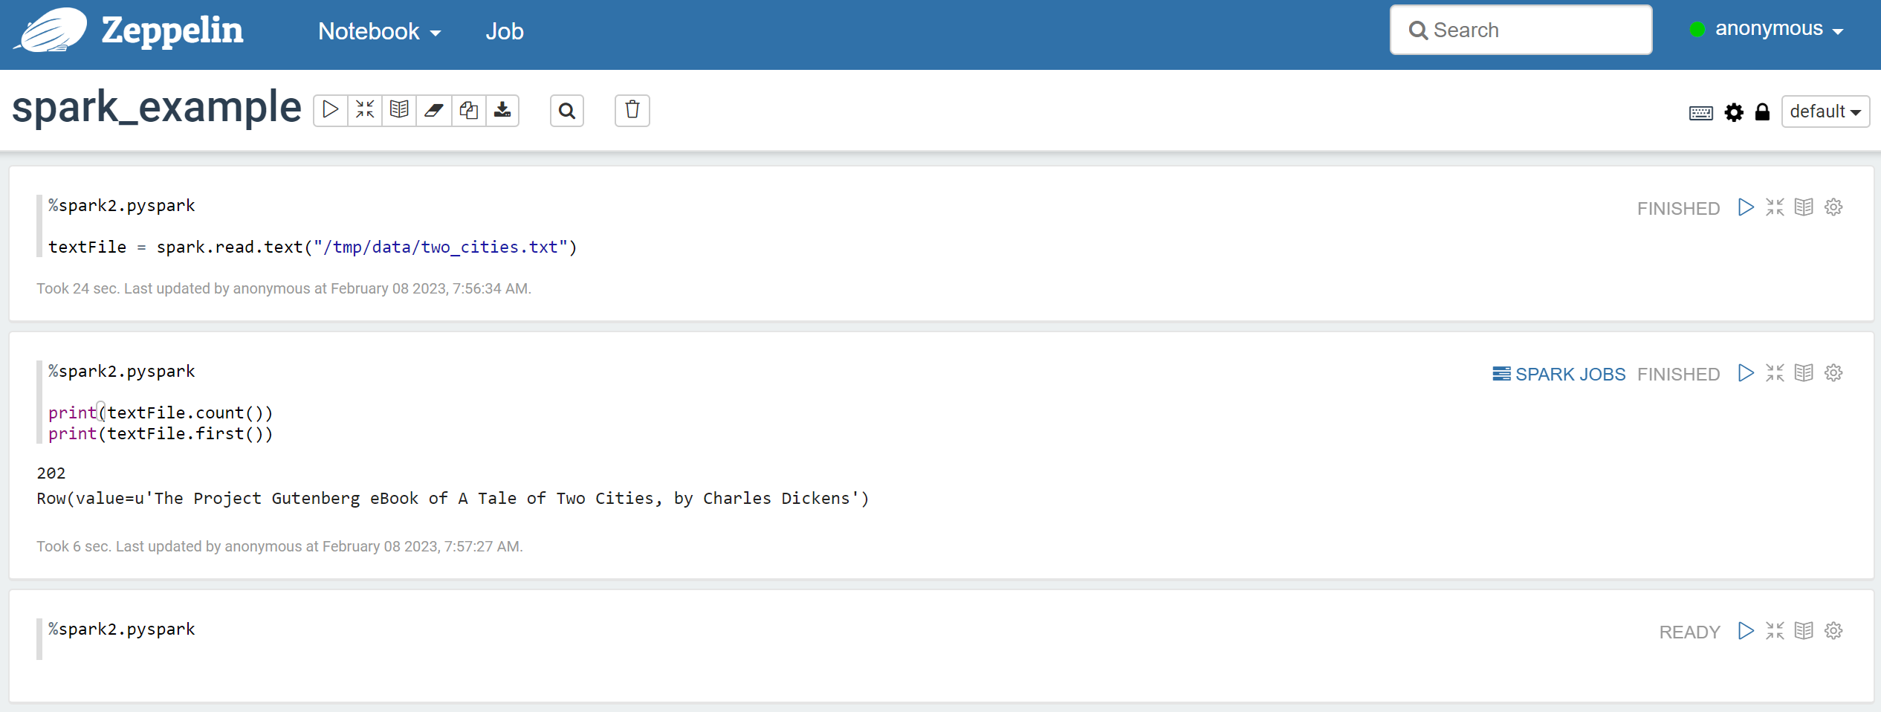
Notebook Interface
A paragraph – a block of scripts in a notebook. Running a paragraph executes all its codes in top-down order
Paragraph status and Run button
Notebook’s name, can click on to modify
Output part of a paragraph. Any outputs will show right below the codes
Code part in a paragraph, can have multiple statements

Slide 12
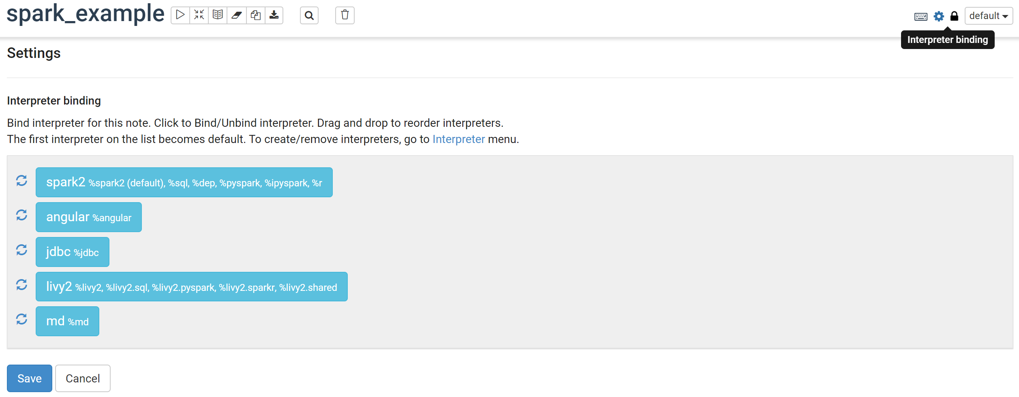
Binding Interpreter
A zeppelin notebook must be bind to an interpreter for the codes to run
After creating the notebook, click on the Interpreter binding button, then click Save

Slide 13
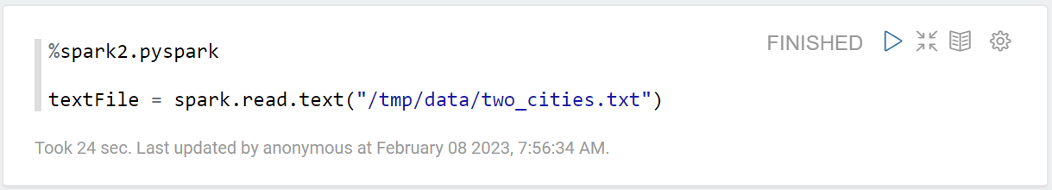
Writing and Running Codes
Each paragraph must begin with defining the interpreter
We will use pyspark for the rest of the Spark modules, the interpreter for pyspark is %spark2.pyspark
In a new cell, type the code like the cell below, then click Run (or Shift + Enter on keyboard)
If you uploaded the data correctly, there should be no outputs besides the log, similar to the output below

Slide 14
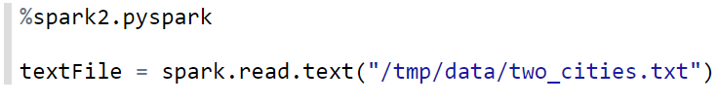
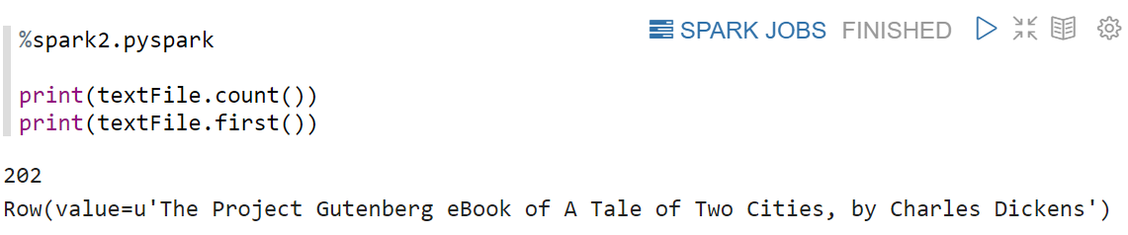
Reading Text Data
spark.read.text() loads a text file from HDFS into a RDD text dataset
The RDD dataset is named textFile per the instruction from the code
Examples of functions for RDD datasets
count(): returns the number of rows in the data
In this example, return the number of lines
first(): prints the first row in the data

Slide 15
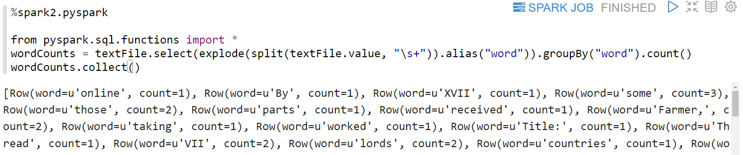
Word Count Example
The word count MapReduce example can be implemented very easily in pyspark
Enter the code below to a new paragraph and run, you should see a list of all words and their frequencies in the two_cities.txt file
%spark2.pysparkfrom pyspark.sql.functions import *
wordCounts = textFile.select(explode(split(textFile.value,"\s+")).alias("word")).groupBy("word").count()
wordCounts.collect()

Slide 16
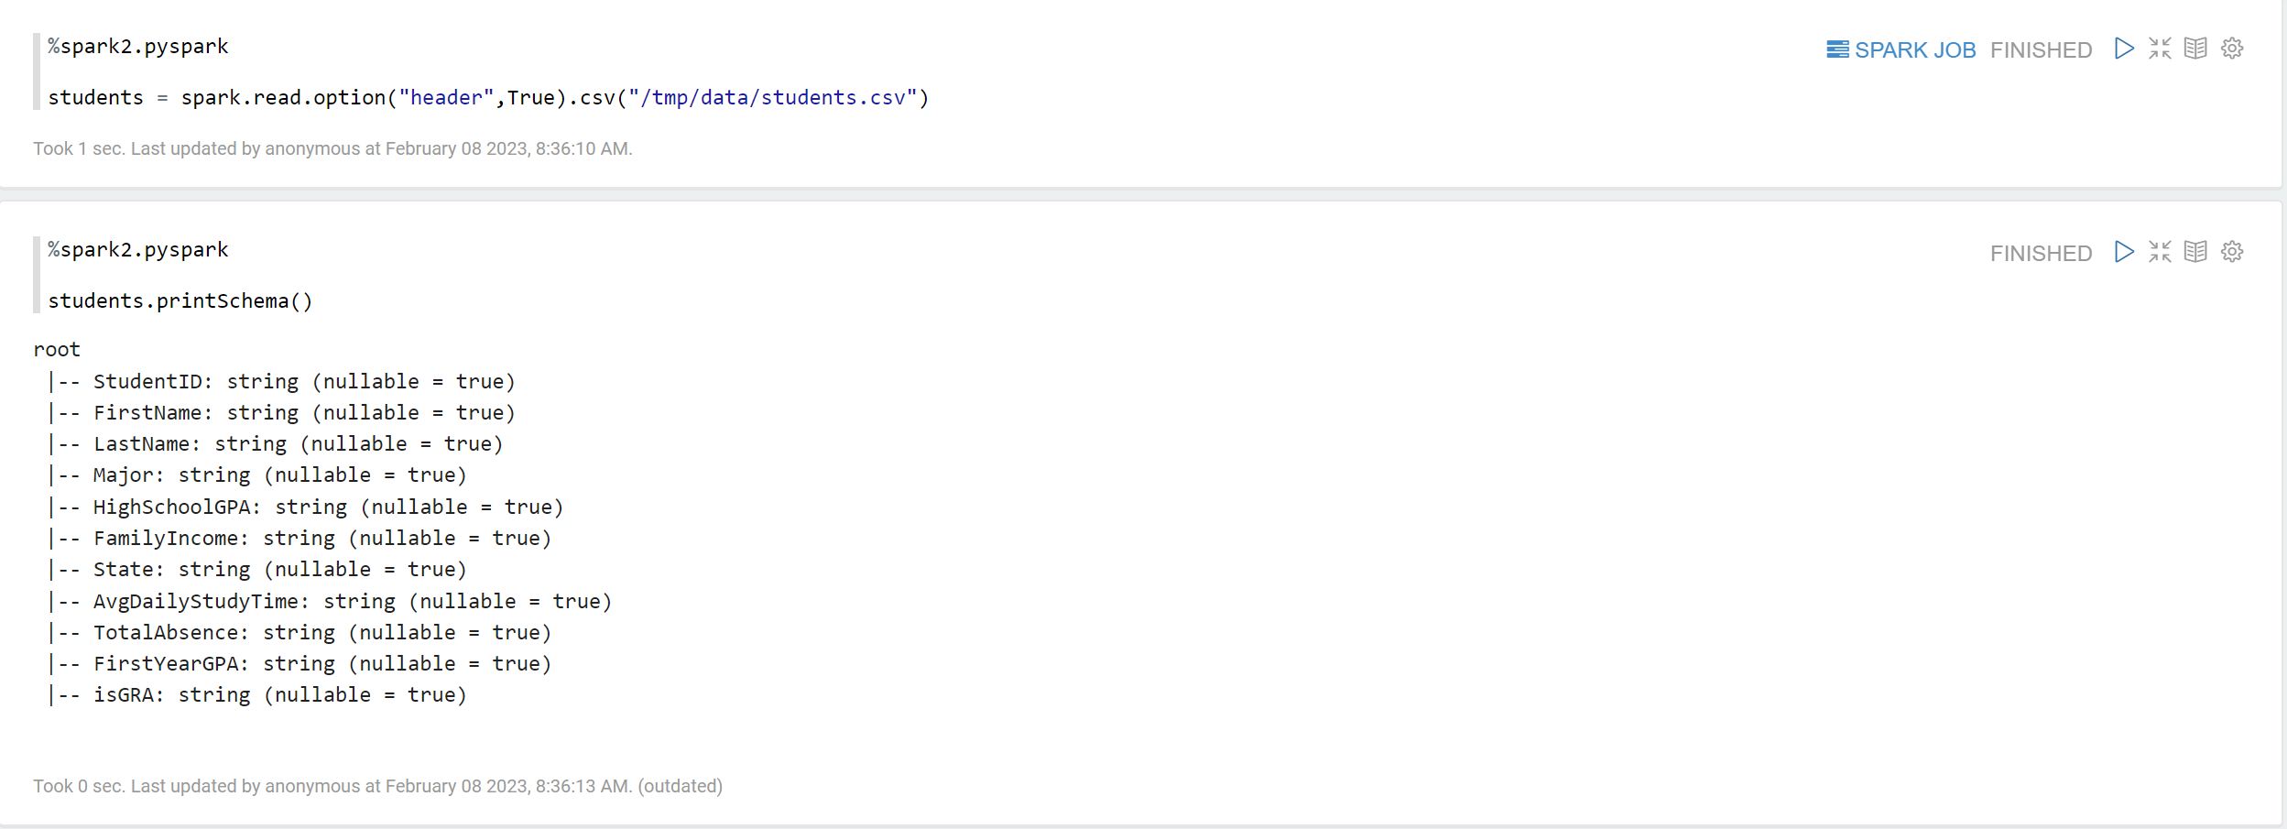
Load Structured Data
Texts are referred to as unstructured data
Structured data is similar to data in tables in the relational databases that you have known
Upload the students.csv to /tmp/data/ in your HDFS before running codes in the two cells below
The file is csv with headers (column names), so we need to set header to True
printSchema() shows the columns and their types

Slide 17
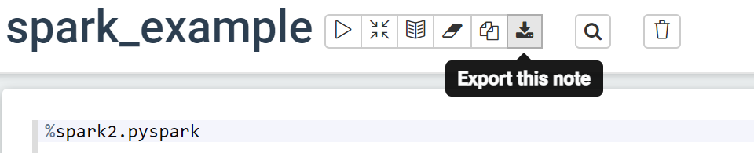
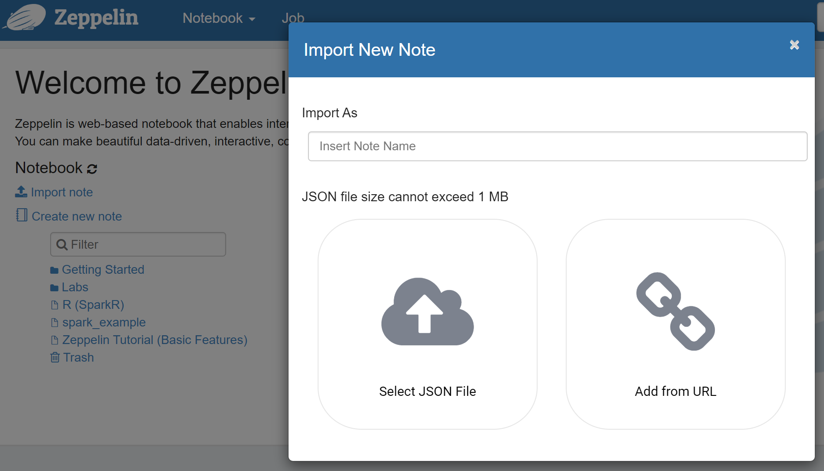
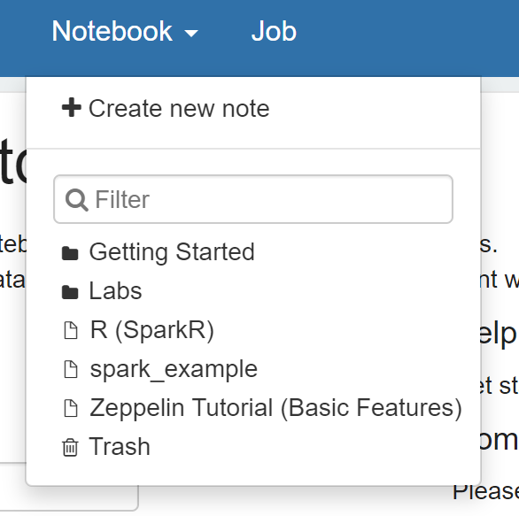
Save and Load a Notebook
A notebook can be exported as JSON file using the Export this note option
The notebook can then be imported back and loaded from the Notebook option

Slide 18
Assignment
Upload the heart_disease.csv file to your HDFS /tmp/data/ folder
Create a new Zeppelin notebook
Load the heart_disease file in as a RDD dataset
Print the dataset schema
Please submit a screenshot of all the codes and the dataset schema

Slide 19
More Readings
https://www.javatpoint.com/apache-spark-tutorial
https://www.tutorialspoint.com/apache_spark/apache_spark_rdd.htm

